Slide 1

Jake Carney, Brandon Bejarano, Michal Zajac, Mason Wittofski, Waleed Kambal

Slide 2
Project Focus
Our project is focused on designing an inventory management system for Guaranty Sheet Metal based in New Orleans, LA.
We're looking to build them a complex web application that they can use to track their current inventory, create and edit incoming and outgoing shipments for jobs and supplies received.
We're also looking into creating a job invoice estimation tool to allow the input of inventory used on a job site to create a cost for the materials of the job.

Slide 3
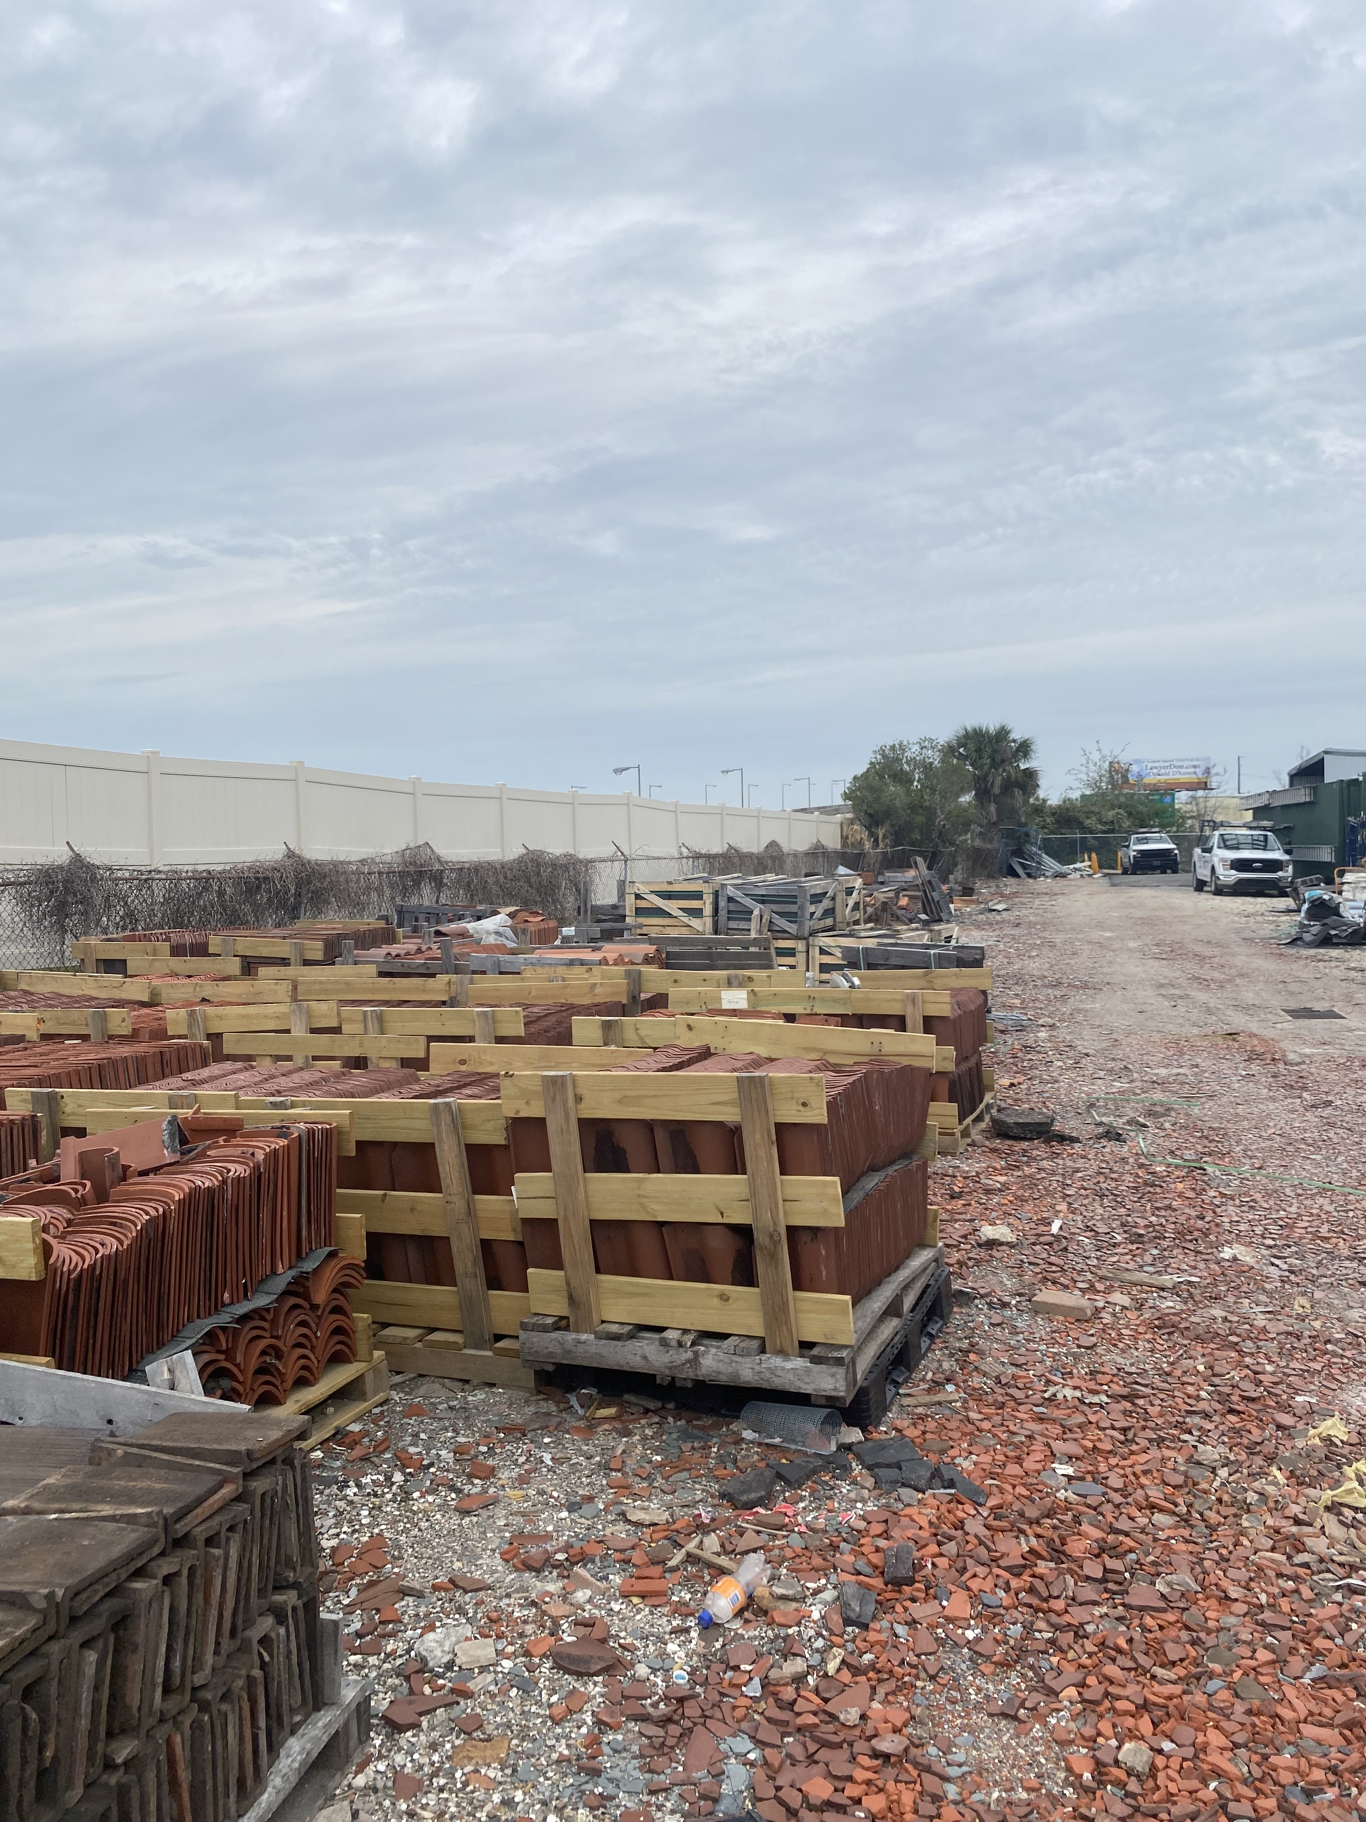
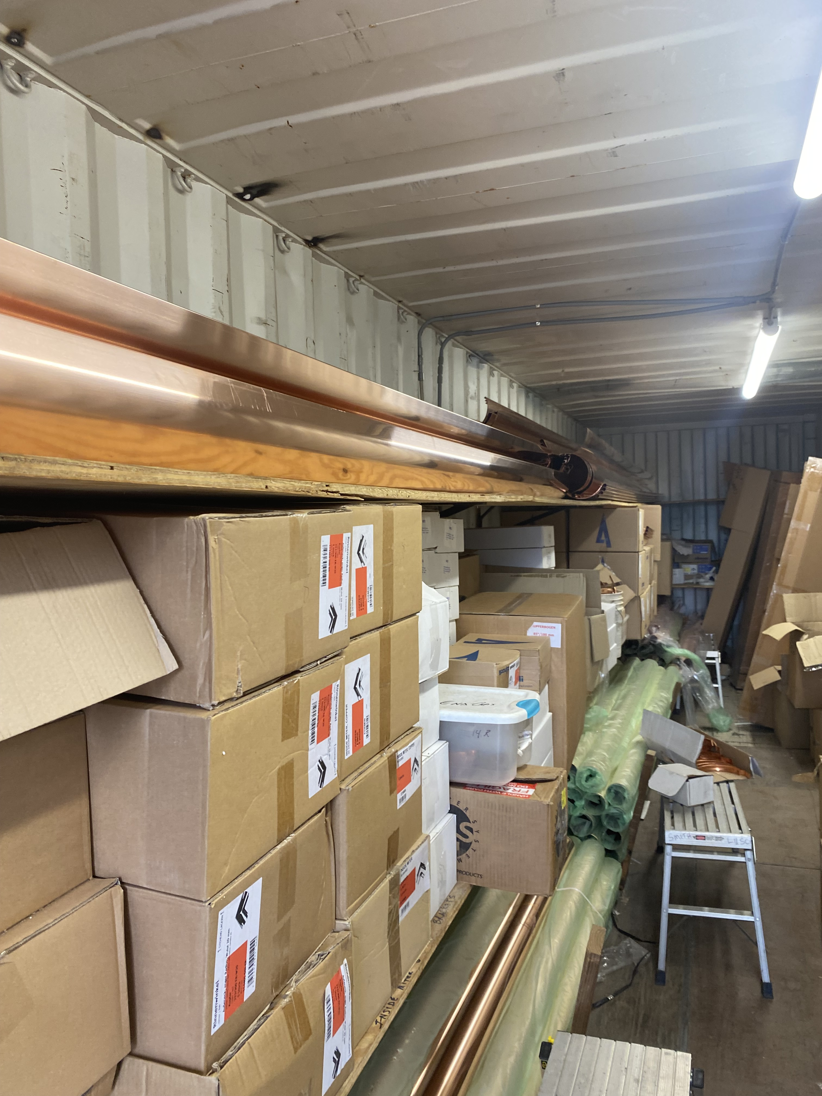
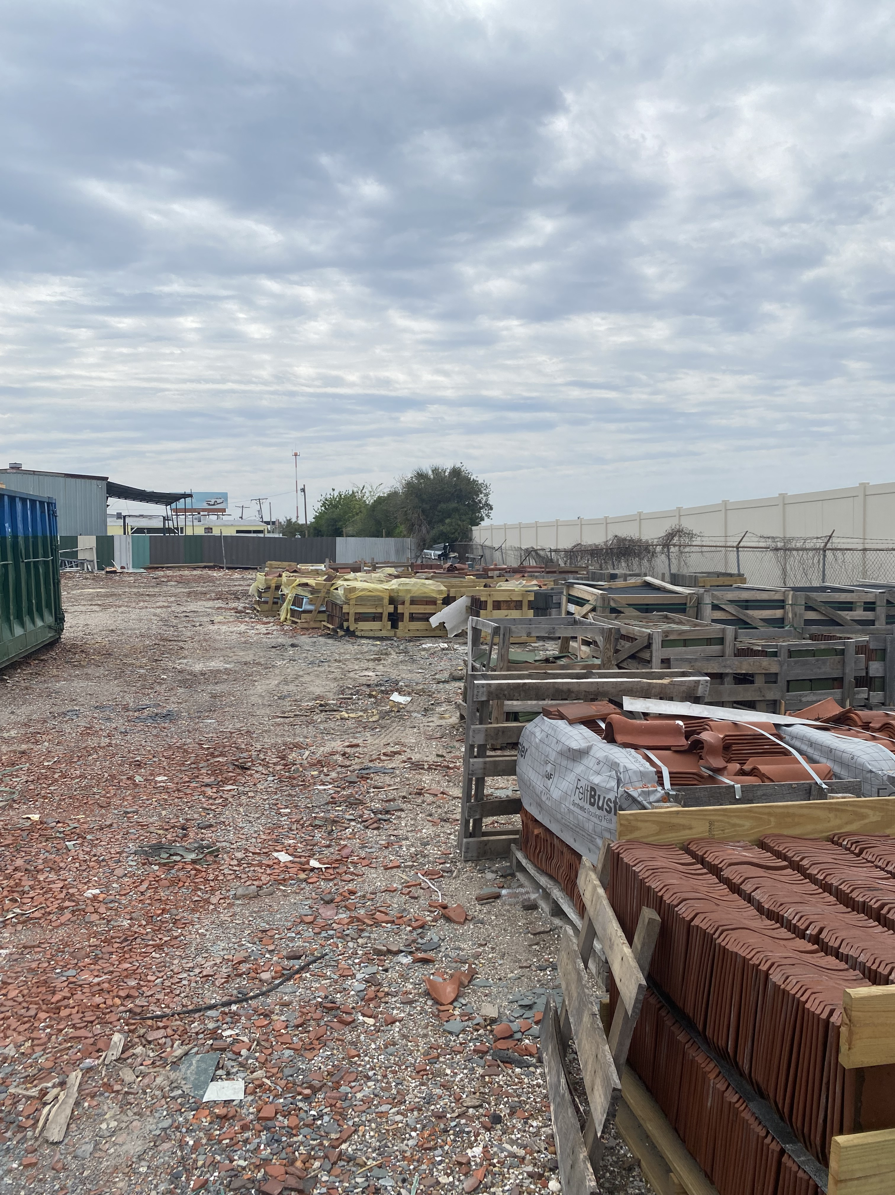
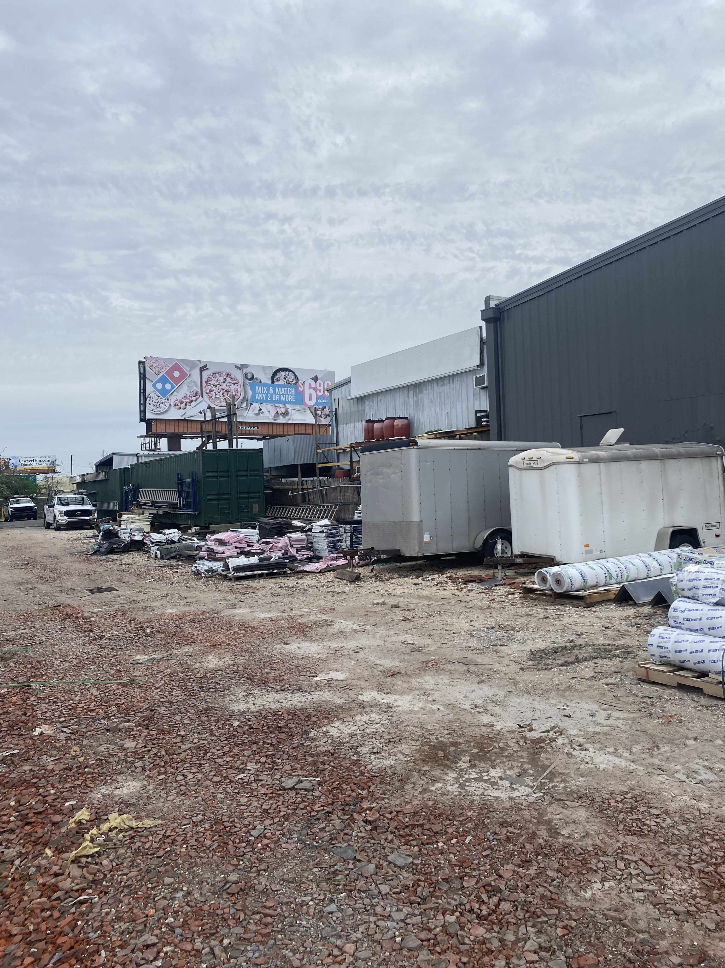
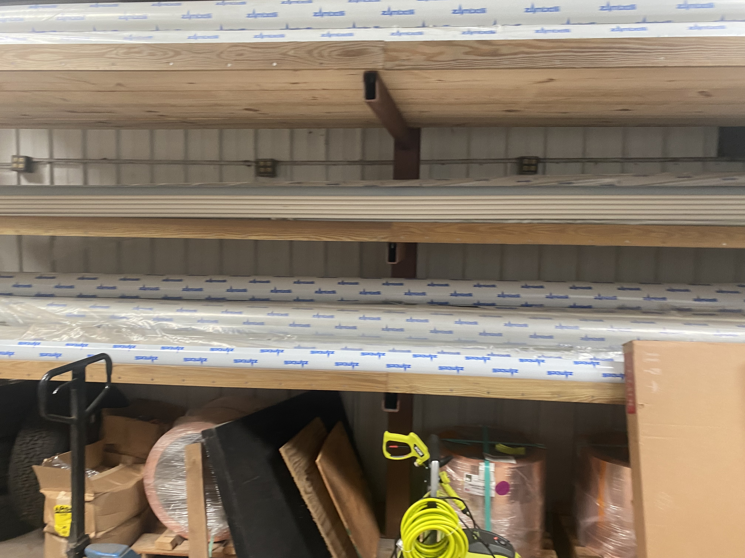

Slide 4
Sprint Goal
Enhance the PostgreSQL database to support new features: Settings, Inventory, Jobs, Purchases, and Dashboard, including setting up database tables and filling them with data
Expand the React front-end application to include new pages (Settings, Inventory, Jobs, Purchases, and Dashboard), ensuring they communicate effectively with the backend through API calls
Extend the REST API using Node.js and Express.js to handle requests from the new front-end components, addressing security concerns and getting API endpoints up

Slide 5
Major Sprint Achievements
Created an inventory page that filters, searches, and deletes stuff, doing all CRUD operations
Setup a reverse proxy
Visited Louisiana to get server info from our client
Created basic charts for the dashboard to get an idea from our Sponsor on what data the wants on the dashboard
Got the Jobs tab implemented with the API to send data to and from the database
Got the Purchases tab implemented with the API to send data to and from the database

Slide 6
Project Backlog and Sprint Backlog
Create the title for FrontEnd of the jobs page
Implement a dropdown function for each job
Setup a reverse proxy
Created a self-signed SSL certificates
Develop CRUD operations within the inventory page
Update database schema to include tables and relations for Settings, Inventory, Jobs, Purchases

Slide 7
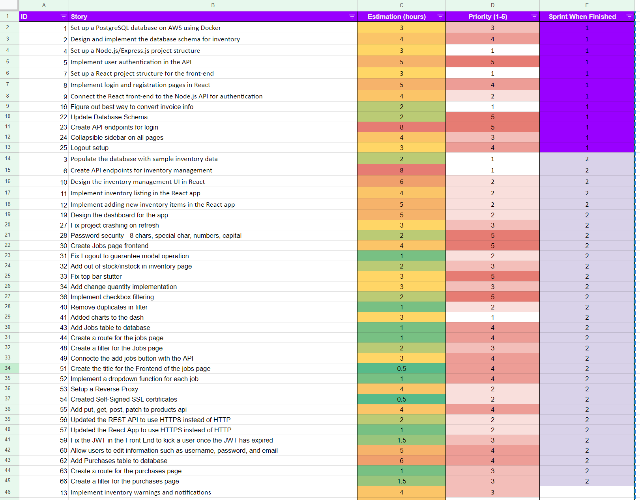

Slide 8
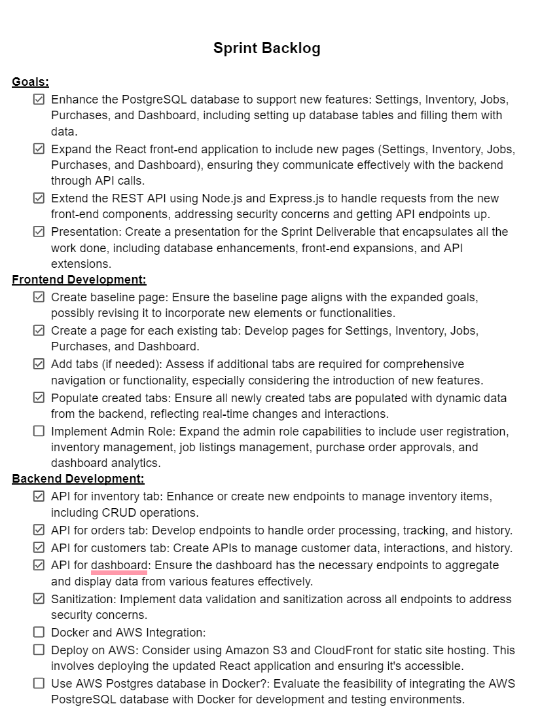

Slide 9
Lessons Learned/Not Completed
Not break main.
Test while we implement. We did not do unit testing as we went and had to catch up. All testing has been done manually in real time using nodemon as we develop.
Communicate with the client more to get more detailed responses.
Be open to changing plans based on feedback and testing results.
While developing, we have put off mobile compatibility more then we should have.

